Slide 1

Bitcoin Throughput Analysis
Final presentation
By : Tal Tzafrir & Itzik Solomon
Supervisor : Alexander Manuskin

Slide 2




Outline
Project goals
Tools
What is bitcoin?
Bitcoin blockchain
Bitcoin scalability problem
Parameters of interest
Block size
UTXO size
Topology
Our setup
Scripts
Results
Difficulties and challenges
Future improvements
conclusions

Slide 3

Project goals
Learn about Bitcoin
Create framework for Bitcoin network analysis
Research how propagation time in network is affected by different aspects

Slide 4

Tools
Bitcoin core – C++ bitcoin client
EC2 – AWS service

Slide 5
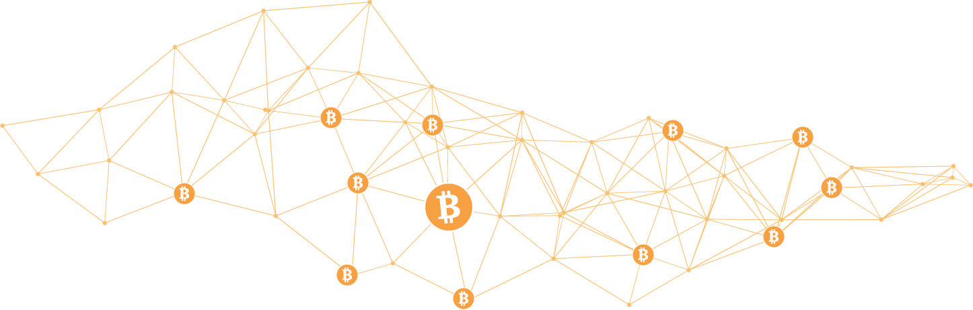

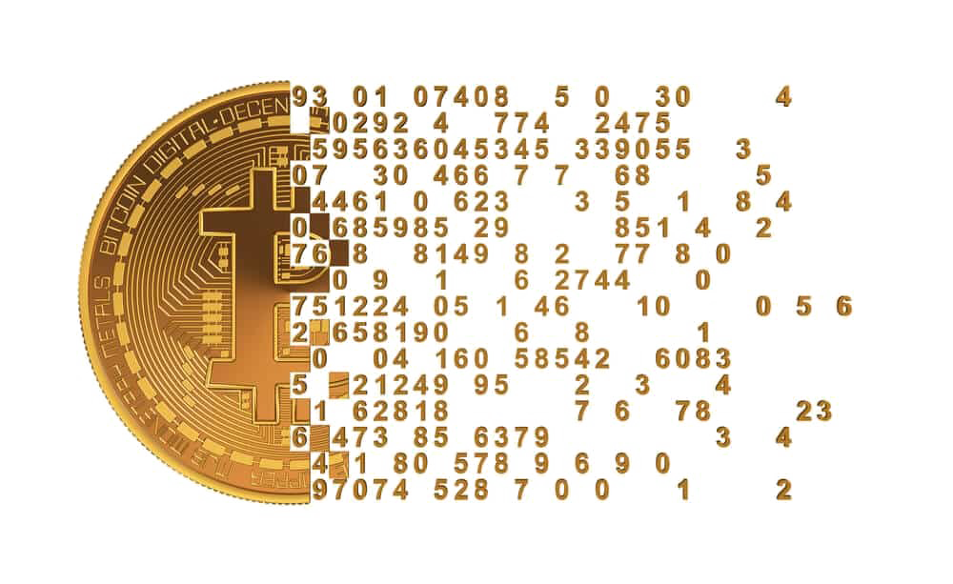
What is Bitcoin?
Most common cryptocurrency
Based on blockchain technology
Solves key cryptocurrency problems

Slide 6

Bitcoin Blockchain
Blocks
Transactions
UTXO set

Slide 7
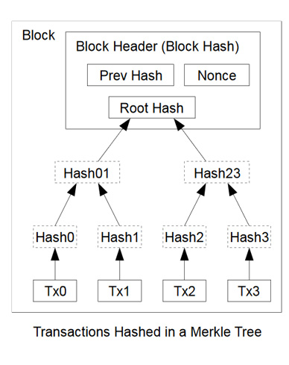
Blocks
Block Version Number
Previous Block Hash
Mining Difficulty Target
Nonce
Transactions

Slide 8
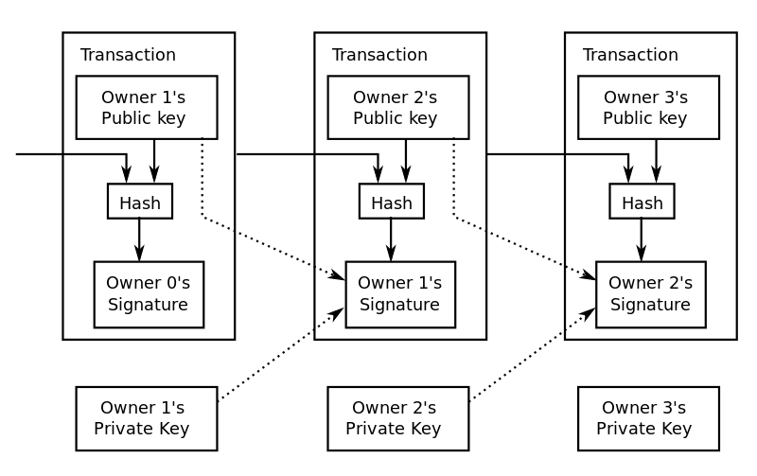
Transactions
Inputs
Prev tx
Index
Private key
Outputs
Value
Public key

Slide 9
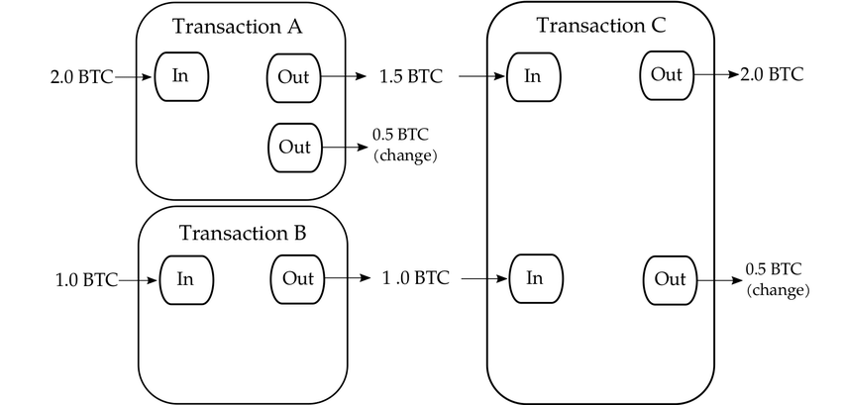
UTXO set example

Slide 10
UTXO set example

Slide 11
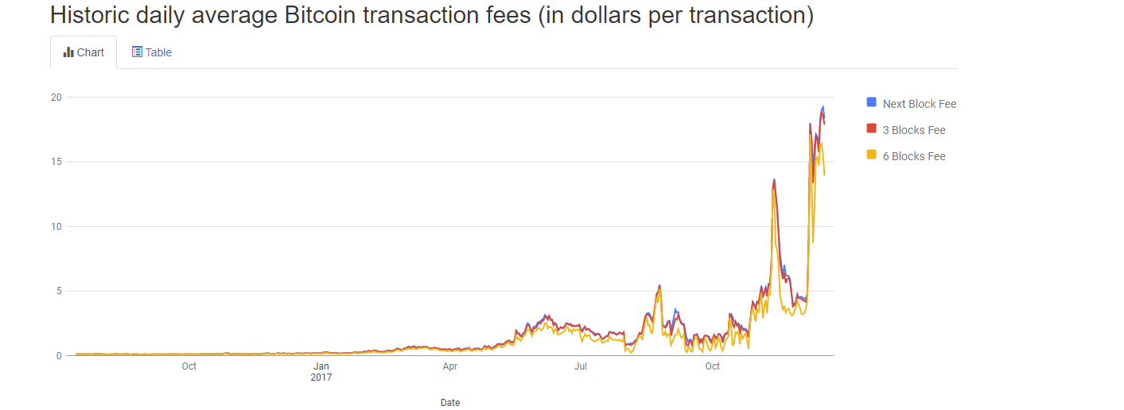
Bitcoin scalability problem
Average block creation time
Block size limit
Efficiency

Slide 12

Parameters of interest
Block size
UTXO set size out of cache size
Topology of nodes
Notes:
UTXO size
Block size
Dependencies
Bandwidth/Latency
Topology
RAM/CPU

Slide 13
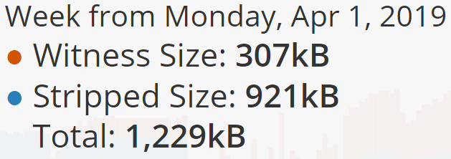
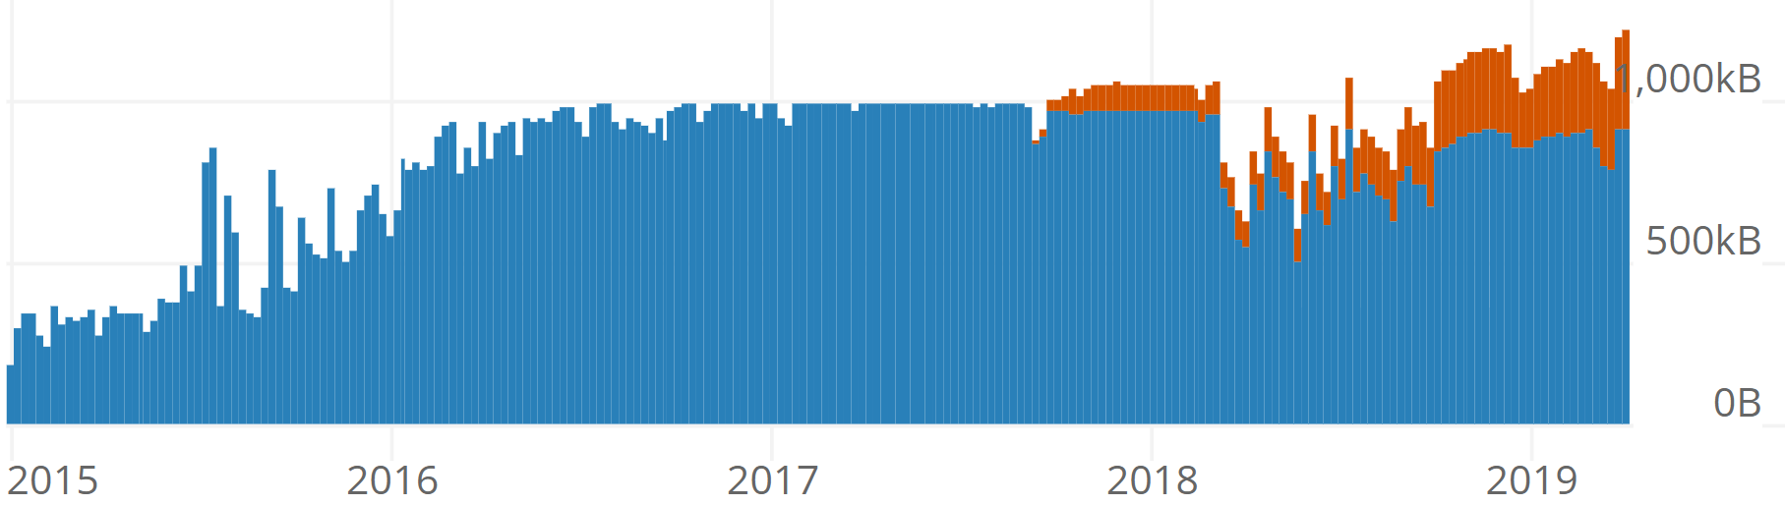
Block Size
Legacy size limitation – 1MB
SegWit and block weight
New theoretical limitation is 4MB
Witness and striped size

Slide 14
UTXO Set Size
Tx input is in UTXO and unspent
dbcache
Notes:
dbcache: Block index
chain state
in-memory UTXO set

Slide 15

Topology
Mesh (clique)
Static (deterministic random)
Dynamic (non-deterministic random)

Slide 16
Our Setup
Local server
Scripts
Library of data directories
results
AWS instances
Bitcoin core client
Server script (only miner)
Block notify script

Slide 17

Scripts

Slide 18



Main script 1/5
Setup all folders needed
Creating initial blockchain
parameters
create_starting_blockchain script

Slide 19
Main script 2/5
Creating AWS instances
AMI
Network settings
Security settings

Slide 20
Main script 3/5
Preparing files at instances
Data directories
Mempool file
block and server scripts

Slide 21
Main script 4/5
Launching nodes
Conf file
Topology
Running bitcoin core
Verifying synchronization of nodes

Slide 22
Main script 5/5
Measurement
Running server.py
Generating block
Polling for results

Slide 23
Creating initial blockchain script
Running node
Generating funds
Creating UTXO set
Creating transactions for block
Moving files

Slide 24
Auxiliary scripts
Block.py
Server.py
Run_multiple_tests.py

Slide 25



results

Slide 26
Block size varied
UTXO set size is 0.9MB, clique topology

Slide 27
UTXO Set size varied
Block size is 1MB, clique topology

Slide 28
Dissemination process - different topologies
Block size is 1MB, UTXO set size is 0.9MB

Slide 29
Different topologies
Block size is 1MB, UTXO set size is 0.9MB

Slide 30


Difficulties and challenges
Bitcoin protocol is only defined by the code itself
Inconsistent AWS operation times
Long transaction sending times
Lack of documentation
Differences between miner node and other nodes
Notes:
Bitcoin protocol is only defined by the code itself – where is defined the size of the block
Lack of documentation – conf file sections
Differences between miner node and other nodes - in conf file

Slide 31


Number of connections
Transaction dependencies
Network bandwidth/latency
Hardware (RAM/cache size, CPU)
Automatically add datadir to AMI

Slide 32


Conclusions
Time of dissemination is linear over block size
UTXO set size something somthing
Processing time at each node is a serious bottle neck

Slide 33

Questions?

